Slide 1
SNS Operations During the COVID-19 Pandemic
Geoff Milanovich
WAO 2021

Slide 2
Outline
Run schedule, Availability
CCR layout/cleaning
Remote tools
Maintenance, Experiment Access
Testing/vaccination
Latest information
* Items highlighted in green are benefits of being associated with a large, multipurpose lab

Slide 3
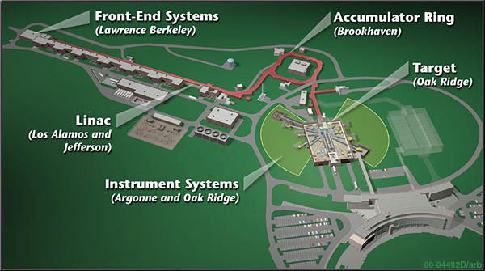
SNS Overview

Slide 4
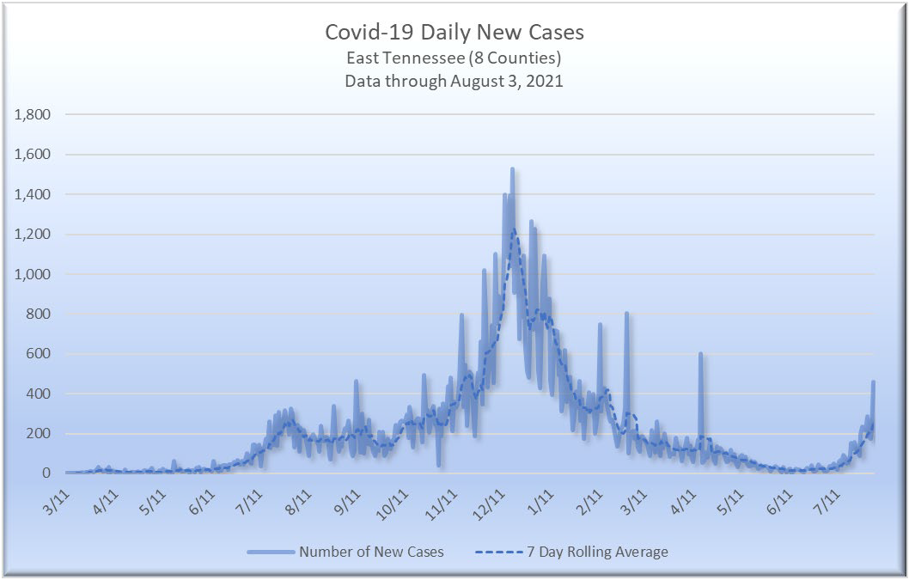
Run Schedules and Cases
Green boxes are run periods
Vaccine available at ORNL
Masks Off
Masks On

Slide 5
ORNL Employees On-Site

Slide 6
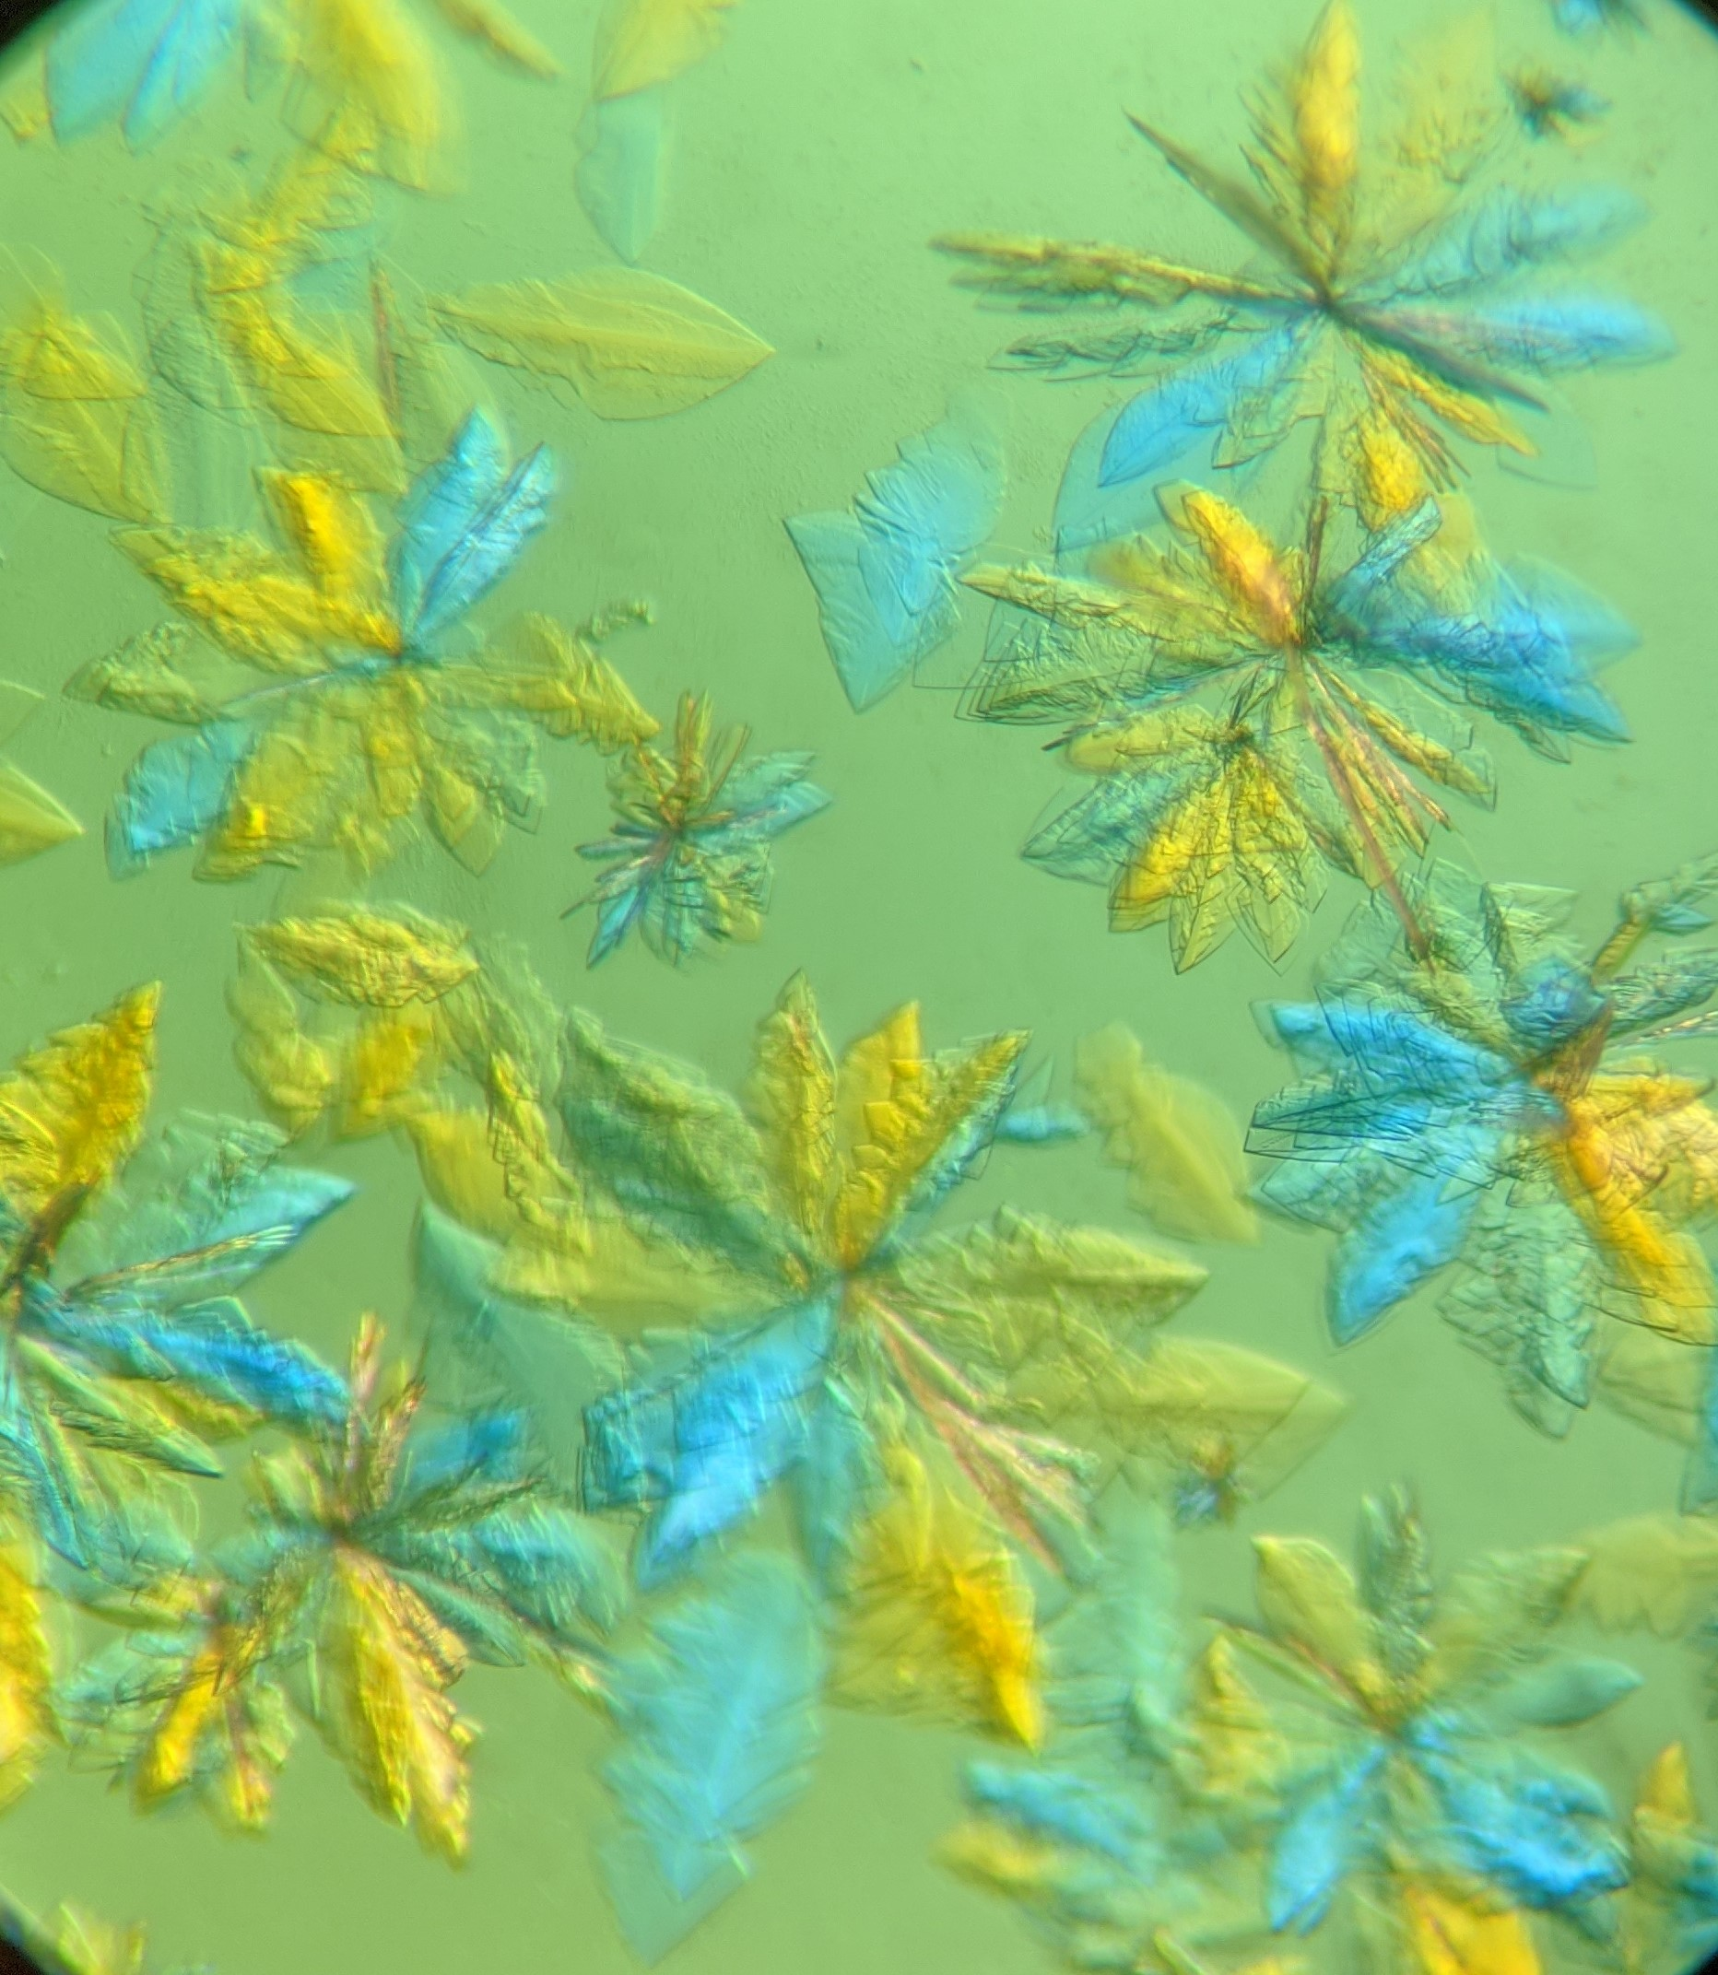
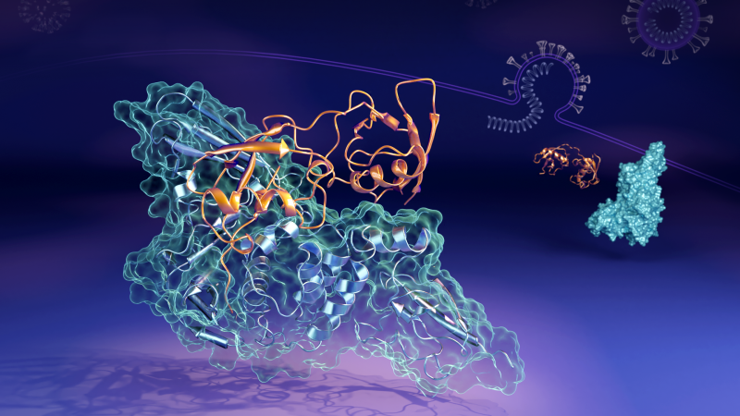
March 2020 Run
Got permission from DOE to run by promoting COVID research – ORNL generated protein samples
Turned on equipment and beam for checkout as normal
Performed accelerator physics measurements and went into “hot standby” for a week while waiting for virus samples to be generated
Beamlines dedicated to COVID research only for ~ 1 month
Otherwise, run schedule not impacted
Credit: ORNL/Daniel Kneller
Credit: ORNL/Jill Hemman

Slide 7
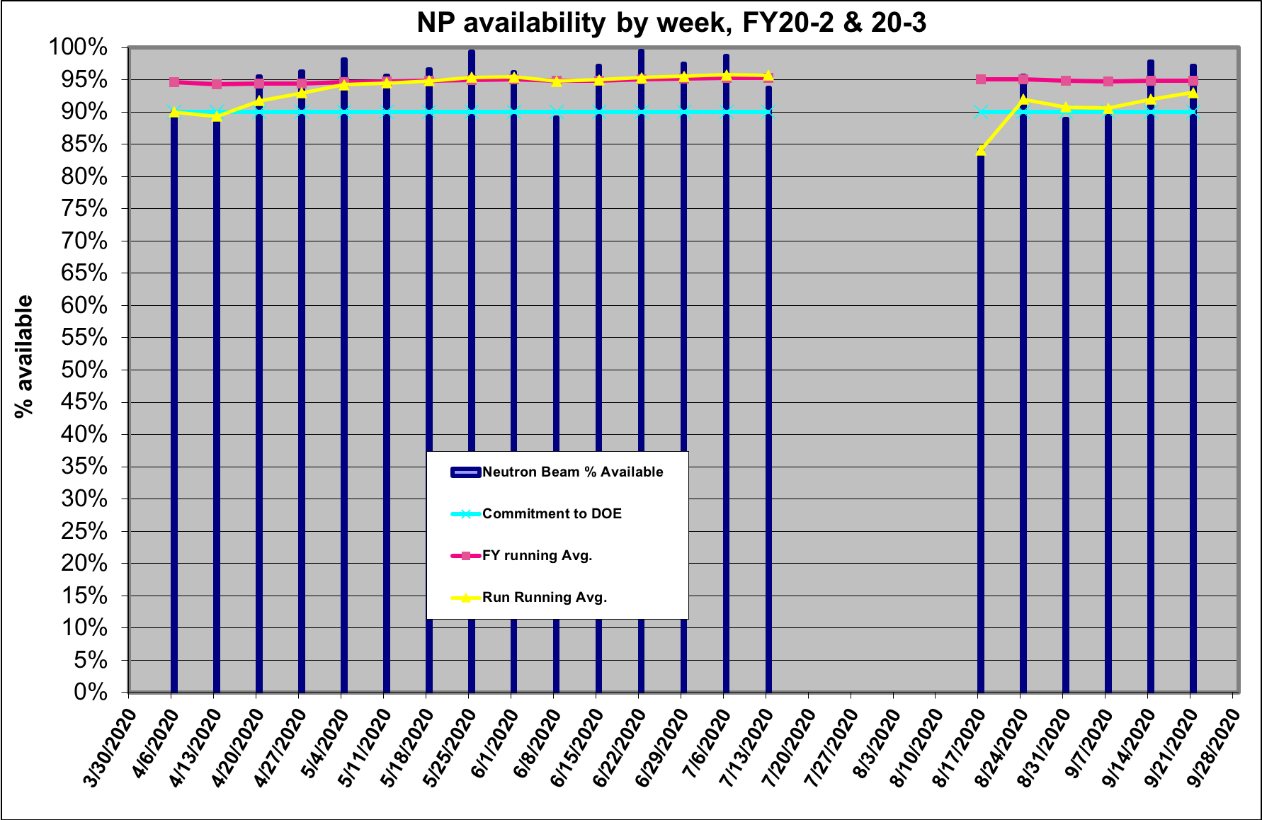
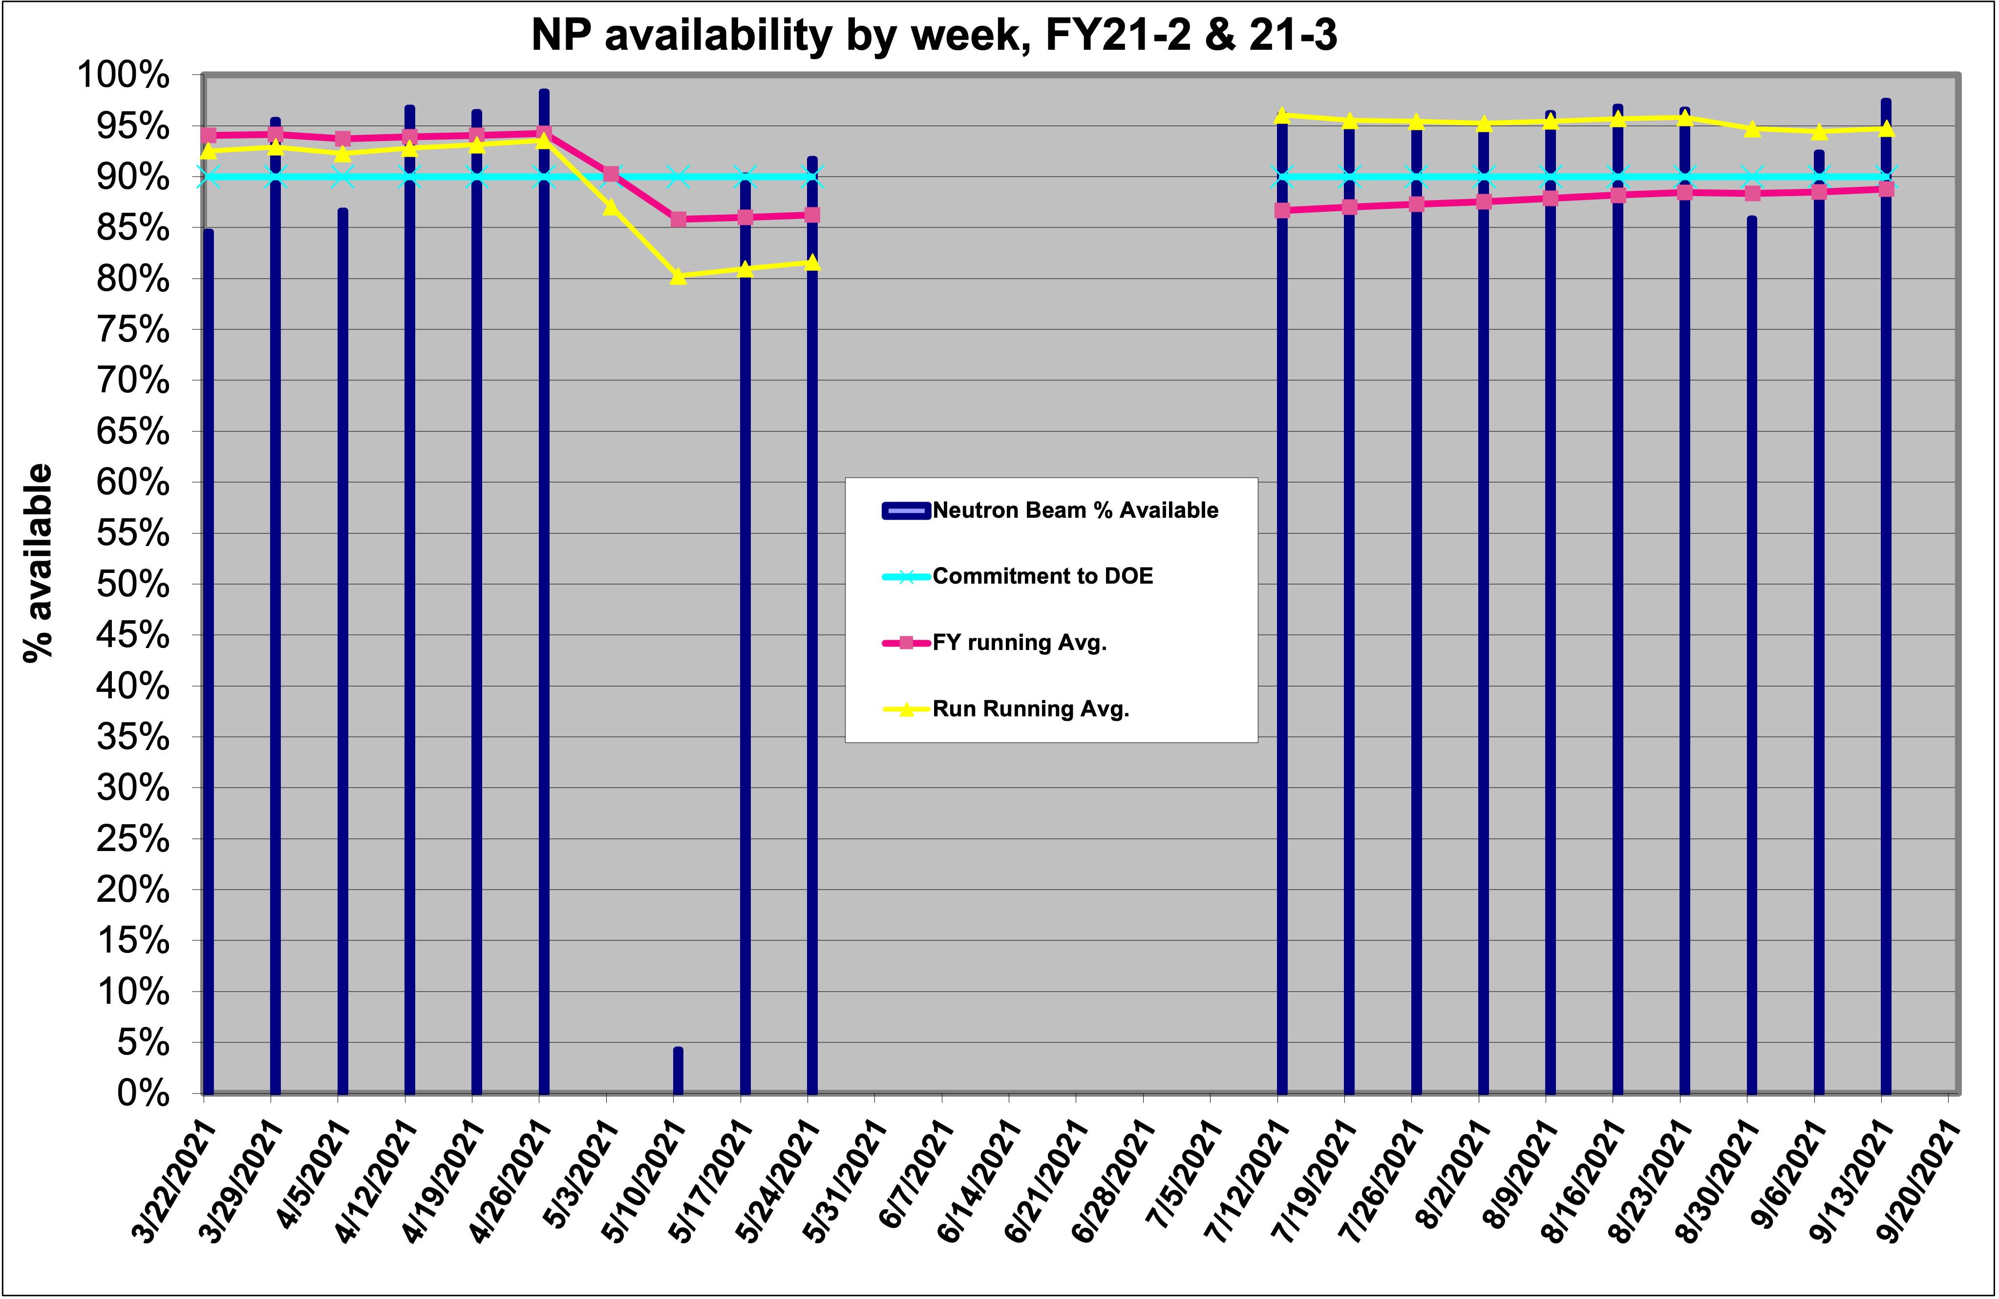
Neutron Production Availability

Slide 8
Central Control Room (CCR) Layout
2 meters between workstations
Boundary Tape
Cleaning Supplies

Slide 9
Cleaning Protocol and Masks
Outgoing crew cleans workstation at end of shift
Oncoming crew cleans workstation (again) at start of shift
Clean common use items (keys, microwave, coffee maker, etc) after each use
Clean workstation if someone else uses it
Did have some difficulty obtaining cleaning supplies
ORNL started manufacturing hypochlorous acid on site June 2020
Masks required during normal business hours, allowed to take it off nights/weekends/holidays unless others (non-ops) present

Slide 10
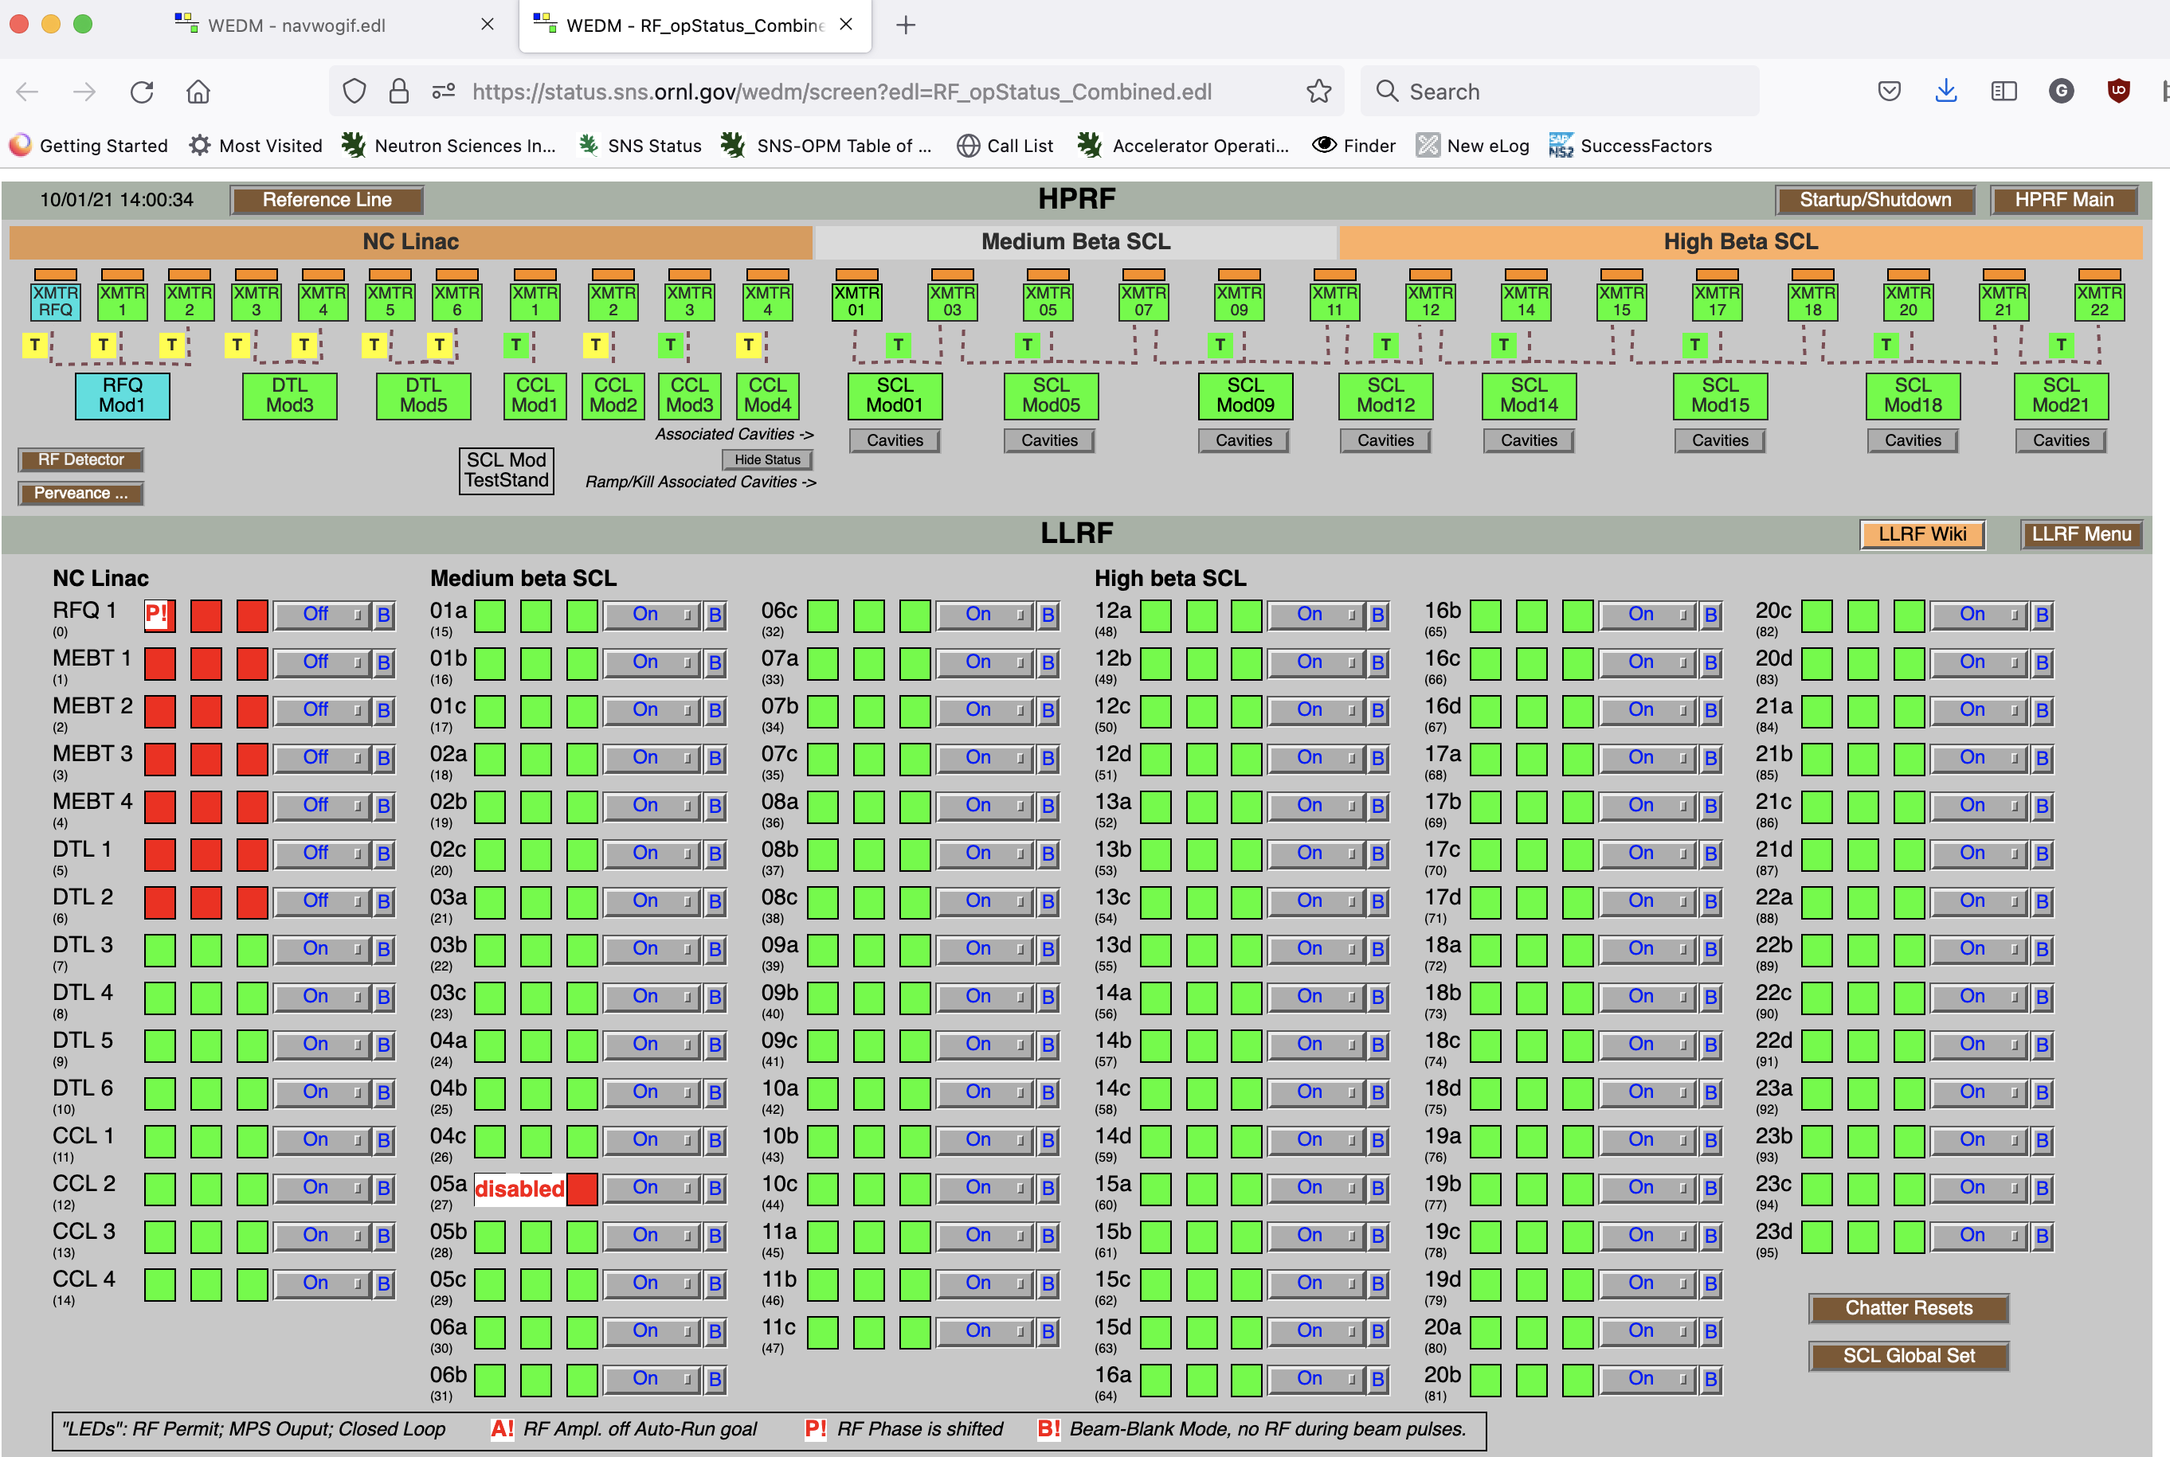
Remote Tools
ORNL beefed up VPN/remote access tools for enterprise network access
WebEDM (JLab product) used for remote monitoring of simple pages- https://github.com/JeffersonLab/wedm
Heavy usage of previously installed gateway to accelerator network for more complex pages/write access
All meetings made virtual, shift turnovers given in Teams

Slide 11
Maintenance/Repairs
SNS model is call-ins for repairs, no major changes
COVID considerations added to Job Hazard Analysis
Lab safety personnel very engaged in planning for COVID controls
Don’t share tools, one person per vehicle, schedule work to reduce person density
Work got done but slowed by distancing, quarantines for different groups
Flexibility in scheduling was key

Slide 12
Experiment Access
ORNL users only in the beginning
Expanded to include 75 mile radius (University of Tennessee)
Mail in sample program expanded
Remote experiment program implemented to improve real-time remote data access
IHC (experiment ops) role expanded to include changing samples, more operation of sample environment, coordination of activities to maintain social distancing, maintaining cleaning supplies
2 users per experiment allowed starting in January 2022

Slide 13
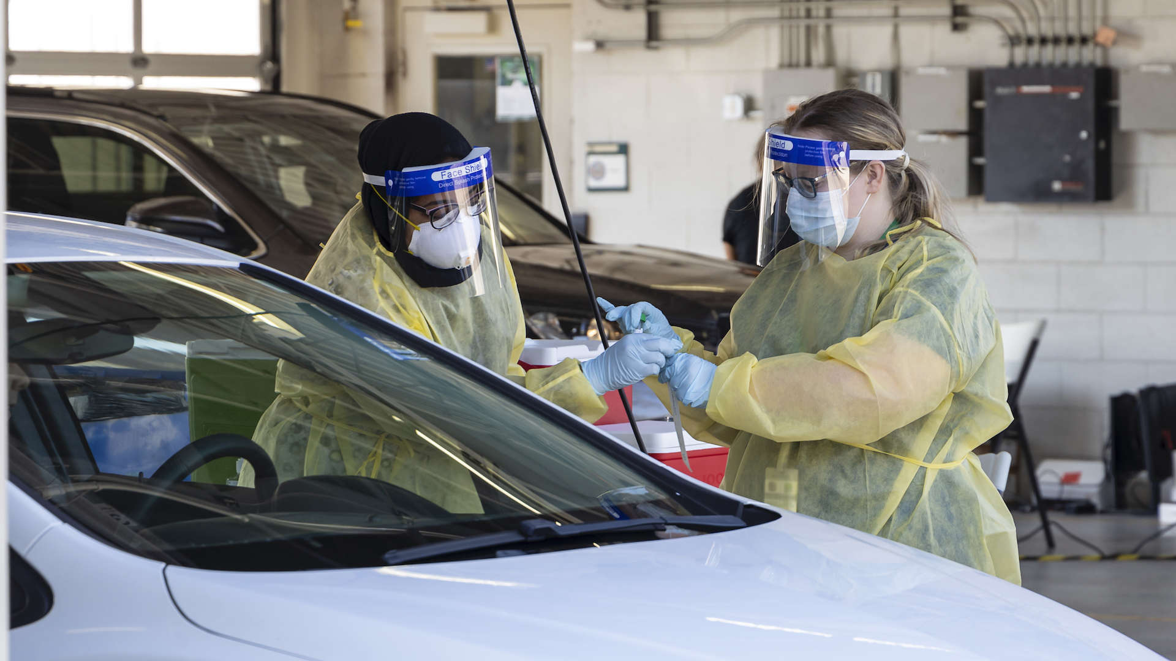
Testing at ORNL
58000+ PCR tests of ORNL personnel through Aug ’21, free to employees
Operations and other “essential personnel” tested every 2 weeks, drive through testing, results usually same day
Enhanced testing after trips/vacations
Rapid testing of close contacts
No impact to accelerator operations from testing/quarantines
Credit: ORNL/Genevieve Martin

Slide 14
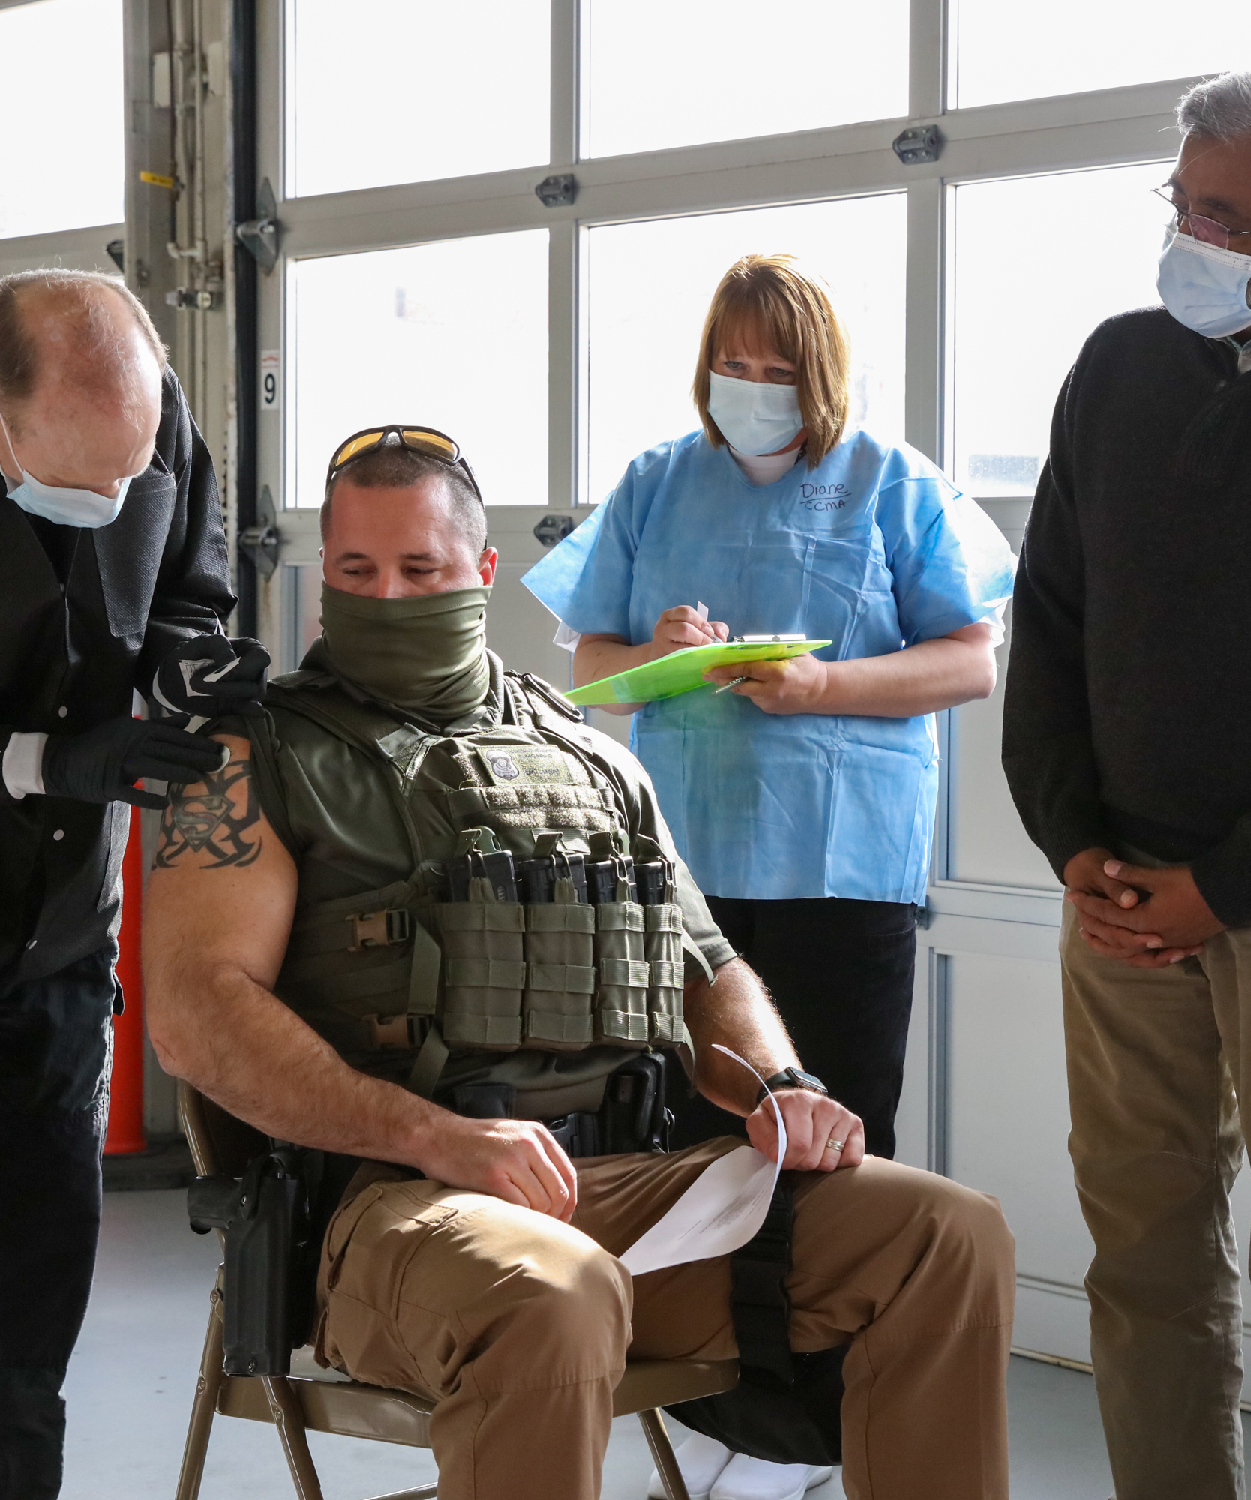
Vaccination
Vaccines initially very difficult to get in the community
ORNL lobbied hard to receive vaccine, received it mid-March 2021
Operators and other “essential personnel” received priority access, most had first dose within a week
ORNL vaccination rate ~ 85% as of Aug 2021 (5600 staff/contractors)
Credit: ORNL/Genevieve Martin

Slide 15
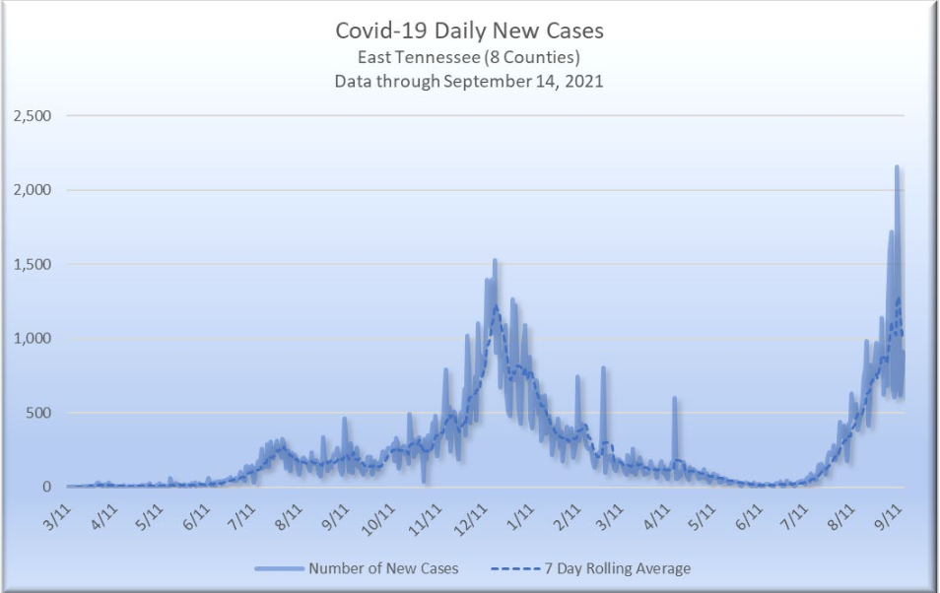
Latest Info and Delta Variant

Slide 16
Latest Info and Delta Variant
Vaccine required for lab employees both on-site and off-site by Oct. 15
Medical or religious exemption allowed, but uses vacation or leave without pay - not just allowed to work from home or get tested frequently/wear mask
As of 10/1 - 970 total cases across ORNL, 65000 tests given, > 90% vaccinated

Slide 17
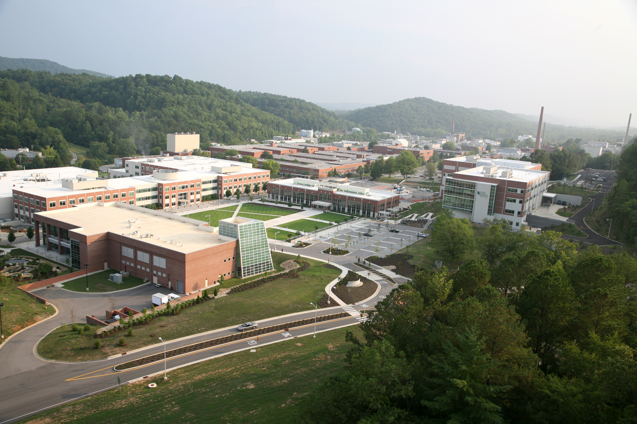
Conclusions
SNS was already (unknowingly) well set up for reduced on-site staffing/social distancing
Good practices, conscientious operators (at work and at home), rapid testing, and luck prevented large-scale quarantines among operations staff
Being part of a much larger lab provided many benefits
ORNL Main Campus

